Slide 1
COT5615: Math for Intelligent Systems I
Anand Rangarajan
Lecture 18

Slide 2
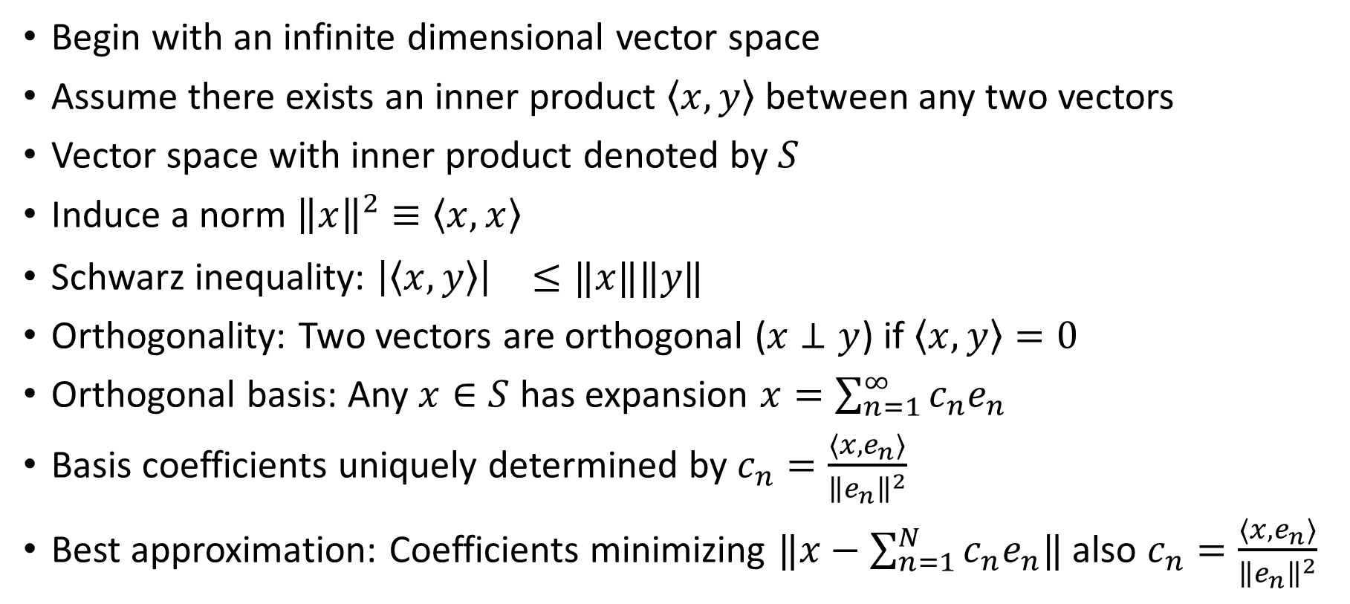
Hilbert Spaces: The Story So Far
Begin with an infinite dimensional vector space
Assume there exists an inner product $\left\langle x,y\right\rangle$ between any two vectors
Vector space with inner product denoted by $S$
Induce a norm ${\left\|x\right\|}^{2}≡\left\langle x,x\right\rangle$
Schwarz inequality: ${\left|\left\langle x,y\right\rangle \right|}^{}≤‖x‖‖y‖$
Orthogonality: Two vectors are orthogonal ($x⊥y$) if $\left\langle x,y\right\rangle =0$
Orthogonal basis: Any $x∈S$ has expansion $x=\sum_{n=1}^{∞}{c_{n}e_{n}}$
Basis coefficients uniquely determined by $c_{n}=\frac{⟨x,e_{n}⟩}{{\left\|e_{n}\right\|}^{2}}$
Best approximation: Coefficients minimizing $‖x−\sum_{n=1}^{N}{c_{n}e_{n}‖}$ also $c_{n}=\frac{⟨x,e_{n}⟩}{{\left\|e_{n}\right\|}^{2}}$

Slide 3
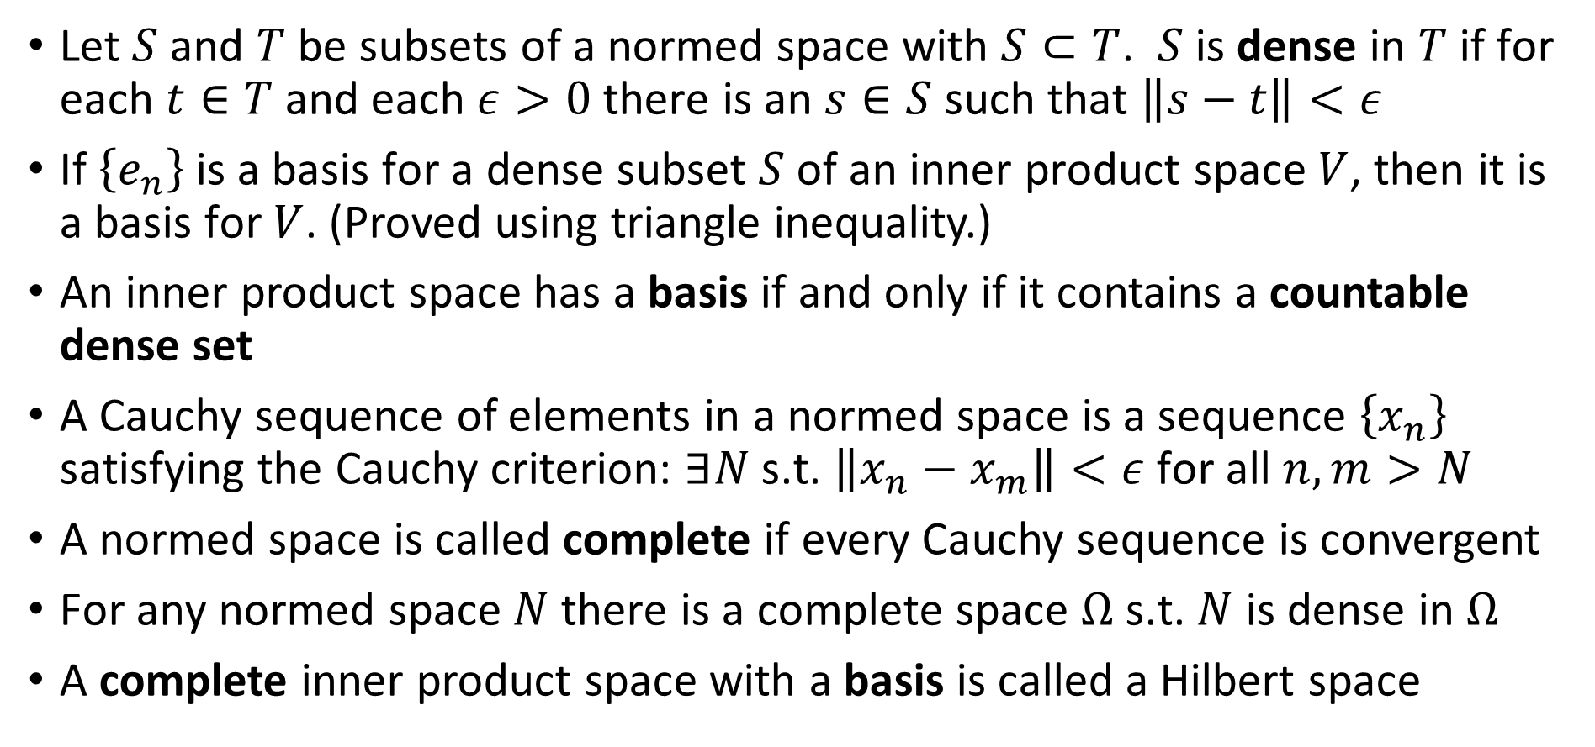
Hilbert Spaces: The Story So Far (contd.)
Let $S$ and $T$ be subsets of a normed space with $S⊂T$. $S$ is dense in $T$ if for each $t∈T$ and each $ε>0$ there is an $s∈S$ such that $\left\|s−t\right\|<ε$
If $\left\{e_{n}\right\}$ is a basis for a dense subset $S$ of an inner product space $V$, then it is a basis for $V$. (Proved using triangle inequality.)
An inner product space has a basis if and only if it contains a countable dense set
A Cauchy sequence of elements in a normed space is a sequence $\left\{x_{n}\right\}$ satisfying the Cauchy criterion: $∃N$ s.t. $\left\|x_{n}−x_{m}\right\|<ε$ for all $n,m>N$
A normed space is called complete if every Cauchy sequence is convergent
For any normed space $N$ there is a complete space $Ω$ s.t. $N$ is dense in $Ω$
A complete inner product space with a basis is called a Hilbert space

Slide 4
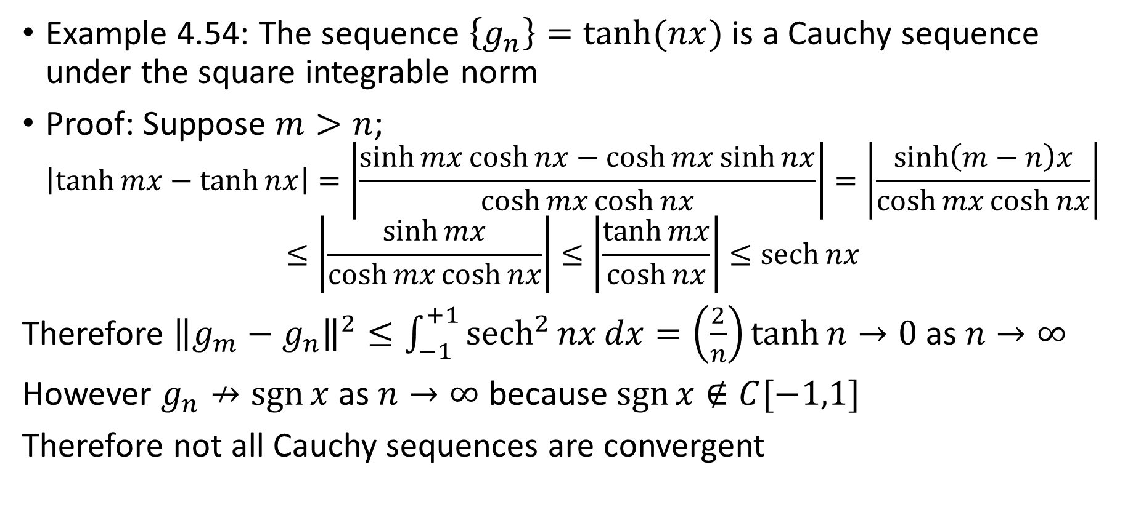
Not all Cauchy sequences are convergent
Example 4.54: The sequence $\left\{g_{n}\right\}=\tanh{(nx)}$ is a Cauchy sequence under the square integrable norm
Proof: Suppose $m>n$;
$$\left|\tanh{mx}−\tanh{nx}\right|=\left|\frac{\sinh{mx}\cosh{nx}−\cosh{mx}\sinh{nx}}{\cosh{mx}\cosh{nx}}\right|=\left|\frac{\sinh\left(m−n\right)x}{\cosh{mx}\cosh{nx}}\right|$$
$$≤\left|\frac{\sinh{mx}}{\cosh{mx}\cosh{nx}}\right|≤\left|\frac{\tanh{mx}}{\cosh{nx}}\right|≤\operatorname{sech}{nx}$$
Therefore ${\left\|g_{m}−g_{n}\right\|}^{2}≤\int_{−1}^{+1}{{sech}^{2}{nx}dx=\left(\frac{2}{n}\right)\tanh{n→0}}$ as $n→∞$
However $g_{n}↛\operatorname{sgn}{x}$ as $n→∞$ because $\operatorname{sgn}{x}∉C[−1,1]$
Therefore not all Cauchy sequences are convergent

Slide 5
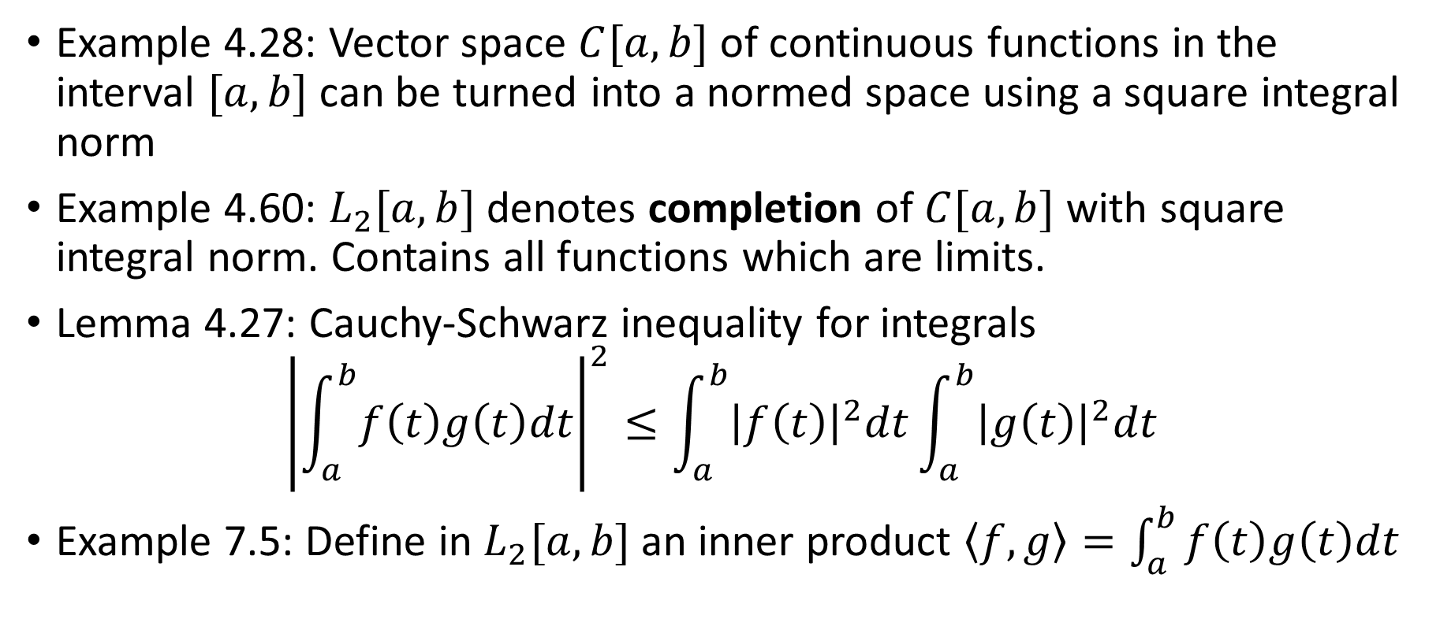
Examples
Example 4.28: Vector space $C[a,b]$ of continuous functions in the interval $[a,b]$ can be turned into a normed space using a square integral norm
Example 4.60: $L_{2}[a,b]$ denotes completion of $C[a,b]$ with square integral norm. Contains all functions which are limits.
Lemma 4.27: Cauchy-Schwarz inequality for integrals
$${\left|\int_{a}^{b}{f\left(t\right)g\left(t\right)dt}\right|}^{2}≤\int_{a}^{b}{{\left|f\left(t\right)\right|}^{2}dt}\int_{a}^{b}{{\left|g\left(t\right)\right|}^{2}dt}$$
Example 7.5: Define in $L_{2}[a,b]$ an inner product $\left\langle f,g\right\rangle =\int_{a}^{b}{f\left(t\right)g\left(t\right)dt}$

Slide 6
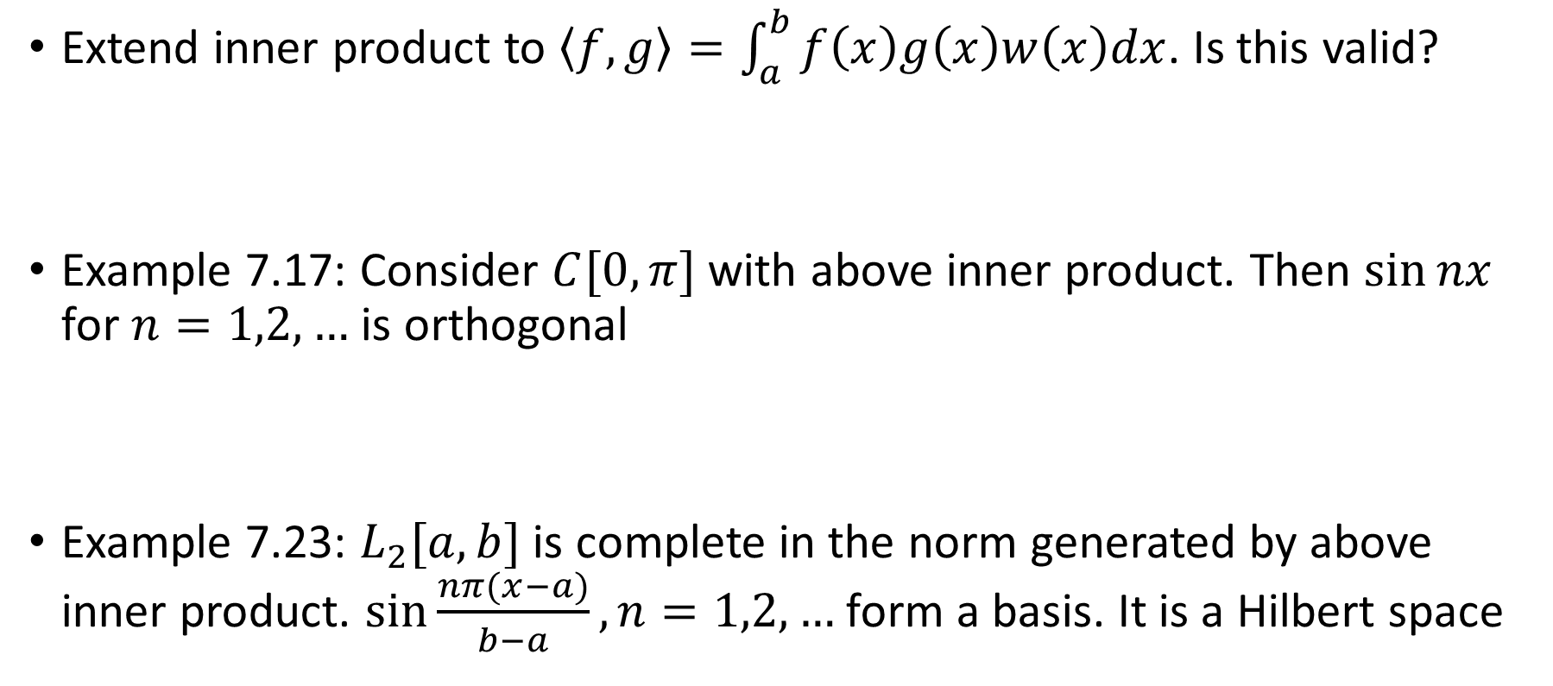
Examples (contd.)
Extend inner product to $\left\langle f,g\right\rangle =\int_{a}^{b}{f\left(x\right)g\left(x\right)w\left(x\right)dx}$. Is this valid?
Example 7.17: Consider $C[0,π]$ with above inner product. Then $\sin{nx}$ for $n=1,2,…$ is orthogonal
Example 7.23: $L_{2}[a,b]$ is complete in the norm generated by above inner product. $\sin{\frac{nπ(x−a)}{b−a}},n=1,2,…$ form a basis. It is a Hilbert space

Slide 7
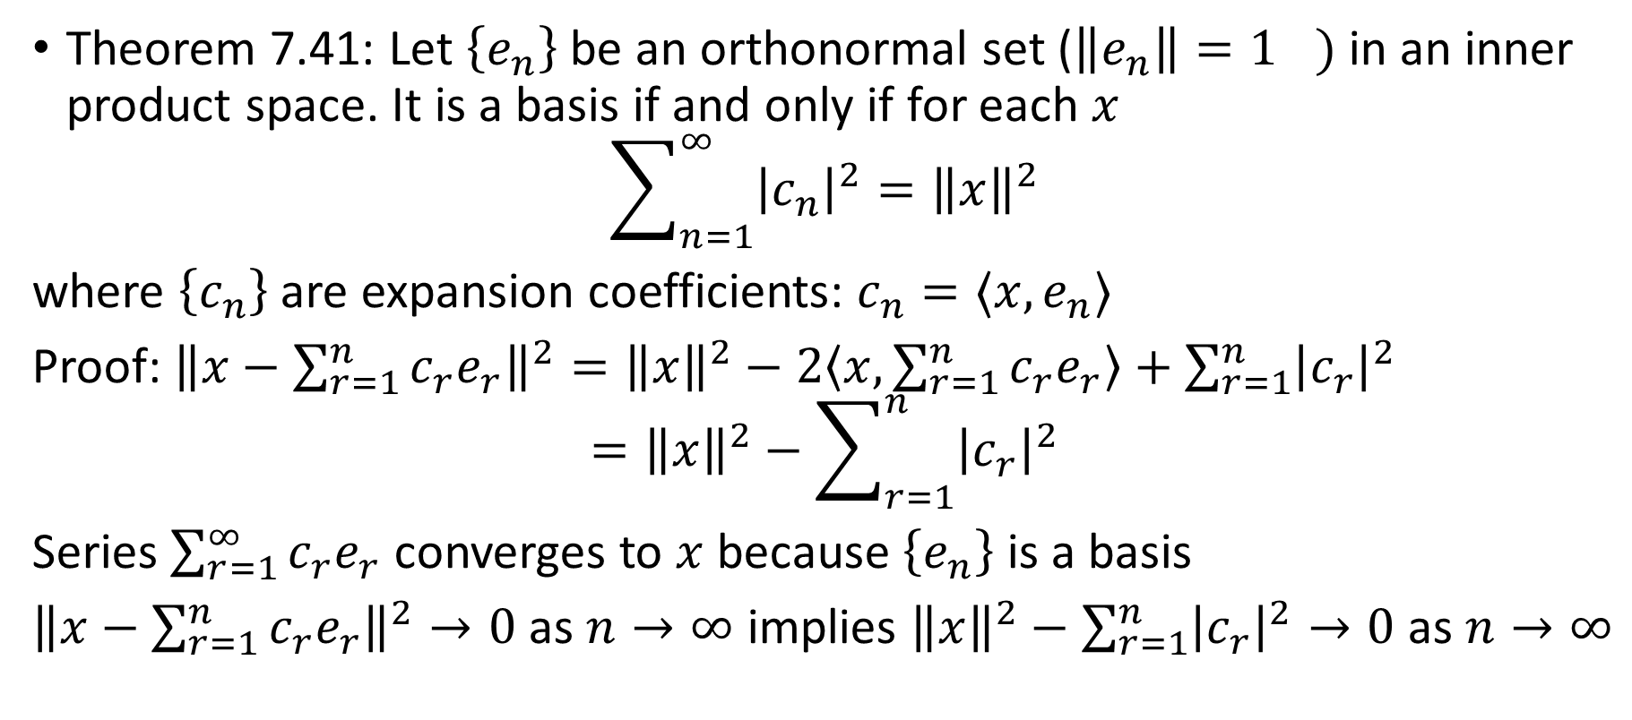
Parseval’s Relation
Theorem 7.41: Let $\left\{e_{n}\right\}$ be an orthonormal set (${\left\|e_{n}\right\|=1}^{})$ in an inner product space. It is a basis if and only if for each $x$
$$\sum_{n=1}^{∞}{{\left|c_{n}\right|}^{2}}={\left\|x\right\|}^{2}$$
where $\left\{c_{n}\right\}$ are expansion coefficients: $c_{n}=⟨x,e_{n}⟩$
Proof: ${\left\|x−\sum_{r=1}^{n}{c_{r}e_{r}}\right\|}^{2}={\left\|x\right\|}^{2}−2\left\langle x,\sum_{r=1}^{n}{c_{r}e_{r}}\right\rangle +\sum_{r=1}^{n}{{\left|c_{r}\right|}^{2}}$
$$={\left\|x\right\|}^{2}−\sum_{r=1}^{n}{{\left|c_{r}\right|}^{2}}$$
Series $\sum_{r=1}^{∞}{c_{r}e_{r}}$ converges to $x$ because $\left\{e_{n}\right\}$ is a basis
${\left\|x−\sum_{r=1}^{n}{c_{r}e_{r}}\right\|}^{2}→0$ as $n→∞$ implies ${\left\|x\right\|}^{2}−\sum_{r=1}^{n}{{\left|c_{r}\right|}^{2}}→0$ as $n→∞$

